Slide 1
FUNCTIONS IN JS (PART 1)
by Ostap Kovbasiuk

Slide 2
WHAT IS A FUNCTION?
A function is a subprogram designed to perform a particular task. They are executed when they are called (this is known as invoking a function). Values can be passed into functions and used within the function. Functions always return a value. In JavaScript, if no return value is spectified, the function will return undefined.

Slide 3

FUNCTION DECLARATION
To create a function declaration you use the function keyword followed by the name of the function. When using function declarations, the function definition is hoisted, thus allowing the function to be used before it is defined.

Slide 4


FUNCTION EXPRESSION
Function Expressions are not hoisted, and therefore cannot be used before they are defined. They can be named or anonymous.
anonymous
named

Slide 5
SCOPE
In JavaScript there are two types of scope:
Local scope
Global scope
Each JavaScript function creates a new local scope, which means that variables defined inside a function are not accessible (visible) from outside the function.

Slide 6
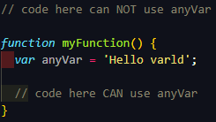
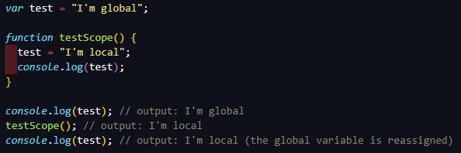
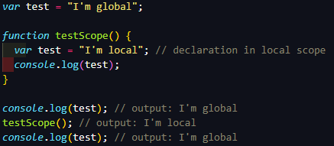
SCOPE

Slide 7

PARAMETERS
Parameters are used when defining a function, they are the names created in the function definition. During a function definition, we can pass in up to 255 parameters they must be separated with commas inside the ( ).

Slide 8
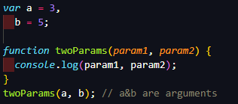
ARGUMENTS
Arguments, on the other hand, are the values the function receives from each parameter when the function is executed (invoked).

Slide 9

ARROW FUNCTIONS
These are anonymous functions with their own special syntax. They operate in the context of their enclosing scope the function or blocks where they are defined.

Slide 10

ARROW FUNCTIONS
If the function body is a single expression, you can leave off the brackets and put it inline. It will just return the result of expression

Slide 11
ARROW FUNCTIONS
If there is only a single argument, you can even leave off the parenthesis around the argument
If you're attempting to use the inline, single-expression syntax but the value you're returning is an object literal you need to wrap the object with parentheses

Slide 12
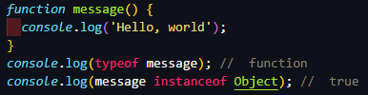
FUNCTION OBJECTS
In JavaScript, functions are objects. You can work with functions as if they were objects. For example, you can assign functions to variables, to array elements, and to other objects. They can also be passed around as arguments to other functions or be returned from those functions.

Slide 13

FUNCTION OBJECTS
You can create a new function object by passing to the built-in Function constructor parameter names and a string of code as body.
Notes:
Many parameters

Slide 14
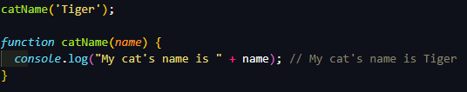
HOISTING
Hoisting is a JavaScript mechanism where variables and function declarations are moved to the top of their scope before code execution.
Notes:
RAM

Slide 15

HOISTING
JavaScript only hoists declarations, not initializations. If a variable is declared and initialized after using it, the value will be undefined

Slide 16
USED LINKS
https://codeburst.io/javascript-functions-understanding-the-basics-207dbf42ed99
https://developer.mozilla.org/en-US/docs/Web/JavaScript/Reference/Functions
https://zendev.com/2018/10/01/javascript-arrow-functions-how-why-when.html
https://www.dofactory.com/tutorial/javascript-function-objects

Slide 17
THANKS FOR ATTENTION

